Slide 1
Section 3.3 Factor Theorem and Remainder Theorem
© Copyright all rights reserved to Homework depot: www.BCMath.ca

Slide 2
Converting From General Form to Factor Form:
Purpose of this lesson is to convert a polynomial from general form to factor form:
General Form:
Factored Form:
Each of these brackets are known as factors
The numbers $r1, r2, …..rn$ are known as roots. They are the X-intercepts
To convert a polynomial function from general form to factor form, we will be using THREE theorems!
  1st Theorem: Factor Theorem
  2nd Theorem: Remainder Theorem
  3rd Rational Root Theorem
We will explain these two theorems first and then learn the conversion to
factor form

Slide 3
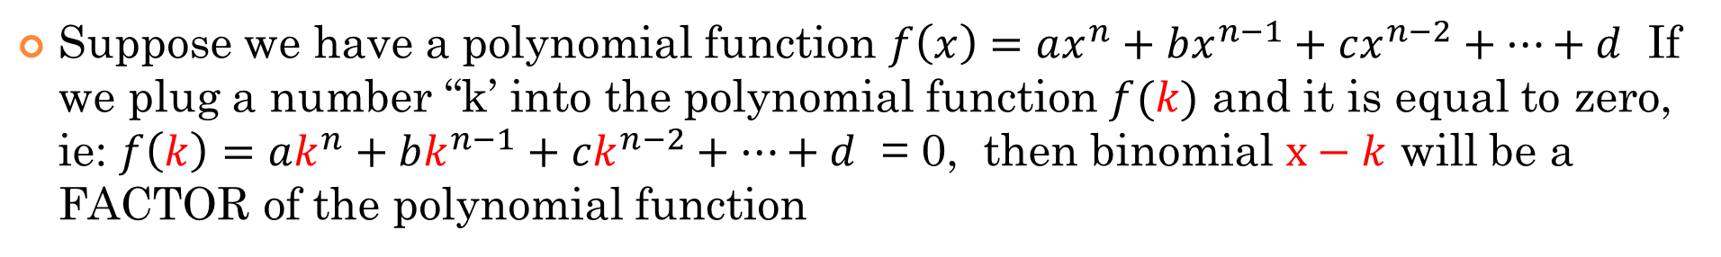
1st Theorem: Factor Theorem:
Suppose we have a polynomial function $f\left(x\right)=ax^{n}+bx^{n−1}+cx^{n−2}+…+d$ If we plug a number “k’ into the polynomial function $f(k)$ and it is equal to zero, ie: $f\left(k\right)=ak^{n}+bk^{n−1}+ck^{n−2}+…+d$ = 0, then binomial $x−k$ will be a FACTOR of the polynomial function
Suppose we have a polynomial function shown below, it has three roots [$−3, −0.5, and 1$] and the function is in the form $f\left(x\right)=ax^{3}+bx^{2}+cx+d$
Then according to Factor theorem then:
and the binomial $x+3 is a factor$
and the binomial $2x+1 is a factor$
and the binomial $x−1 is a factor$

Slide 4
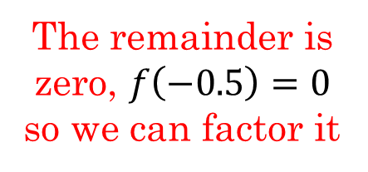
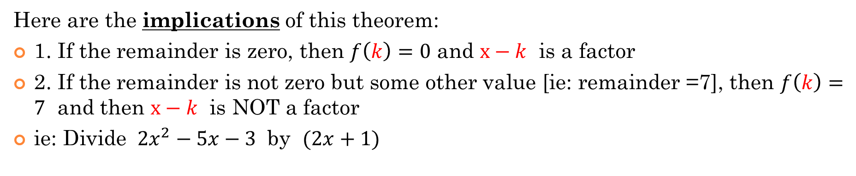
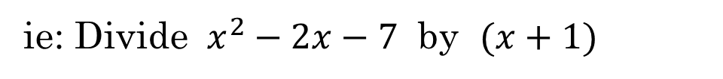
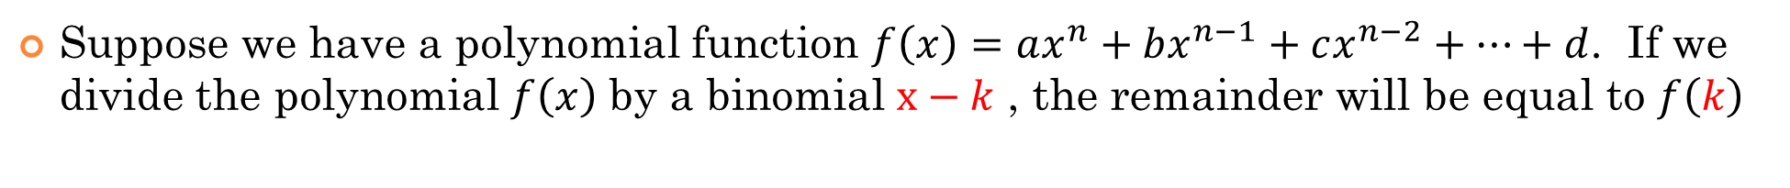
2nd Theorem: Remainder Theorem
Suppose we have a polynomial function $f\left(x\right)=ax^{n}+bx^{n−1}+cx^{n−2}+…+d$. If we divide the polynomial $f\left(x\right)$ by a binomial $x−k$ , the remainder will be equal to $f\left(k\right)$
Here are the implications of this theorem:
1. If the remainder is zero, then $f\left(k\right)=0$ and $x−k$ is a factor
2. If the remainder is not zero but some other value [ie: remainder =7], then $f\left(k\right)=7$ and then $x−k$ is NOT a factor
ie: Divide $2x^{2}−5x−3$ by $(2x+1)$
ie: Divide $x^{2}−2x−7$ by $(x+1)$
The remainder is zero, $f\left(−0.5\right)=0$ so we can factor it
The remainder is NOT zero, so (x+1) is NOT a factor…. Go test another value
The divisor and quotient will be factors!!

Slide 5
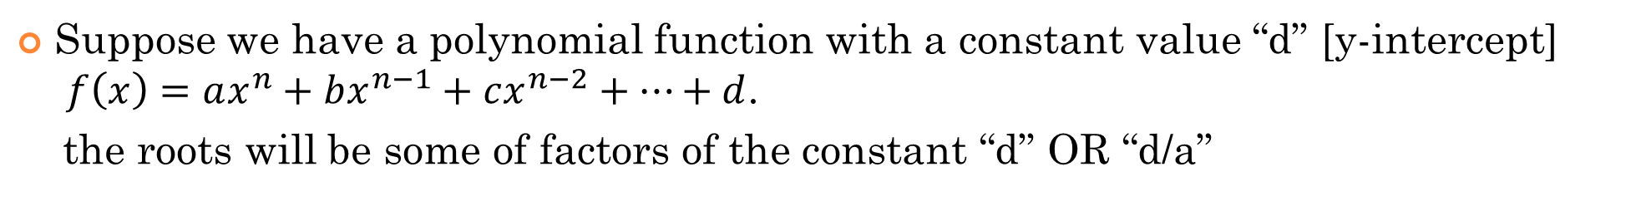
3rd Theorem: Rational Root Theorem:
The purpose of the previous two theorems is find the first factor of the polynomial function. Once you find your first factor, the quotient will also be a factor
Next Question: How do we know what numbers to plug in to find our first factor!?!??
Suppose we have a polynomial function with a constant value “d” [y-intercept]
$f\left(x\right)=ax^{n}+bx^{n−1}+cx^{n−2}+…+d$.
the roots will be some of factors of the constant “d” OR “d/a”
Ie: Suppose we have the polynomial function $f\left(x\right)=x^{3}−x^{2}−10x−8$
If we want to find the factors of this polynomial, start with the factors of ‘$−8$’
Test any of these to see which one is equal to zero to find your first factor

Slide 6
Practice: Given the polynomial, what numbers would you pick to choose to check with the remainder theorem to be a factor?
ii) From the choices above, which of them is a root of the polynomial?
iii) What are the three roots of the polynomial above?

Slide 7
Steps to Convert From General Form to Factor Form:
Here are the STEPS to convert a polynomial function in general form to factor form:
1. Find the factors of the constant term and then use the rational root theorem to see which numbers to test for the first factor
2. Use the remainder thm and Factor thm to find the first factor and root, This is likely to be the most difficult step
3. Divide the polynomial function by the 1st factor to find the QUOTIENT. This is b/c the quotient is also a factor
To make sure that you did this step correctly, your remainder SHOULD be zero!
4. If the quotient is quadratic, factor it using criss-cross, get our factors & DONE!
5. If your quotient is cubic, quartic, or greater degree, then repeat step 1 to 3 until your quotient is quadratic

Slide 8
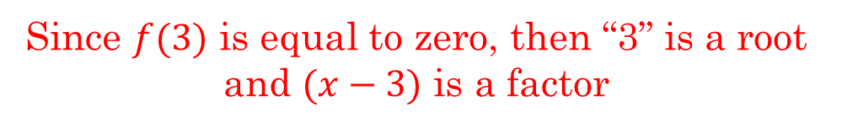
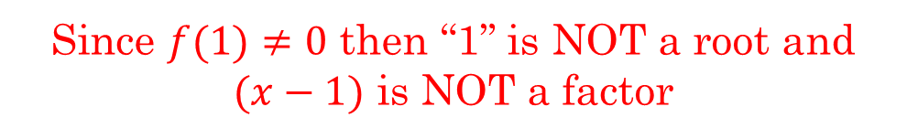
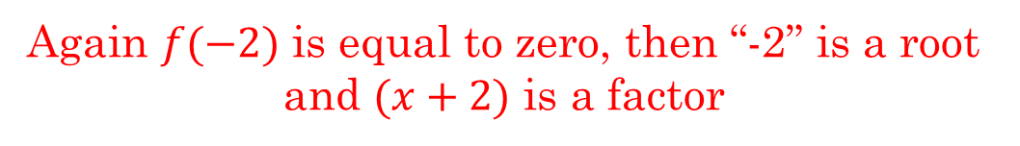
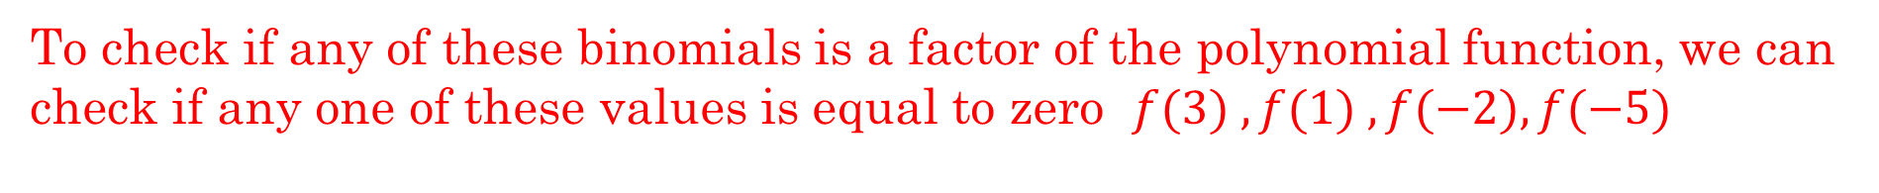
Ex: Given the polynomial function $f\left(x\right)=x^{3}+4x^{2}−11x−30$ which of the following is a factor of the polynomial? $\left(x−3\right),\left(x−1\right),\left(x+2\right), or \left(x+5\right)$
To check if any of these binomials is a factor of the polynomial function, we can check if any one of these values is equal to zero $f(3) , f(1) , f(−2), f(−5)$
Since $f(3)$ is equal to zero, then “3” is a root and $(x−3)$ is a factor
Since $f(1)≠0$ then “1” is NOT a root and $(x−1)$ is NOT a factor
Again $f(−2)$ is equal to zero, then “-2” is a root and $(x+2)$ is a factor
“-5” is a root and $(x+5)$ is a factor

Slide 9
Ex: Which of the following is a factor of f(x)

Slide 10
Ex: Factor each of the following:

Slide 11
Ex: Convert the function to factor form:
Find the First Root: Rem. Thm.
Start with numbers that multiply to the constant term
NOT every number works!
Find the Quotient
Synthetic Division
Factor the Quotient

Slide 12
Ex: Convert the function to factor form:
Find the First Root: Rem. Thm.
Start with numbers that multiply to the constant term
Find the Quotient
Synthetic Division
Factor the Quotient

Slide 13
Practice: Convert the function to factor form:
Find the First Root: Rem. Thm.
Start with numbers that multiply to the constant term
Find the Quotient
Synthetic Division
The Quotient needs to be factored again

Slide 14
Practice: Convert the function to factor form:
Start Over and Find the First Factor for the Quotient
Use the Remainder Theorem
Find the Quotient
Synthetic Division
Factor the Quotient

Slide 15
II) Find the remainder using the Remainder theorem:
ii: When the equation: is divided by
then remainder is 1. What is the value of “m”?
iii) when the equation: is divided by (3x+1) the remainder is 11. Find the value of “m”

Slide 16
Practice: Find the remainder using the Remainder theorem:
Make the dividend equal to f(x)
Use the divisor to find “k”

Slide 17
III) Finding a Missing Constant Using the Remainder Theorem:
Ex: When the equation is divided by
then remainder is 1. What is the value of “m”?
Make the dividend equal to f(x)
Use the divisor to find “k”
Plug in the remainder and solve for “m”

Slide 18
Practice: when the equation: is divided by (3x+1) the remainder is 11. Find m

Slide 19
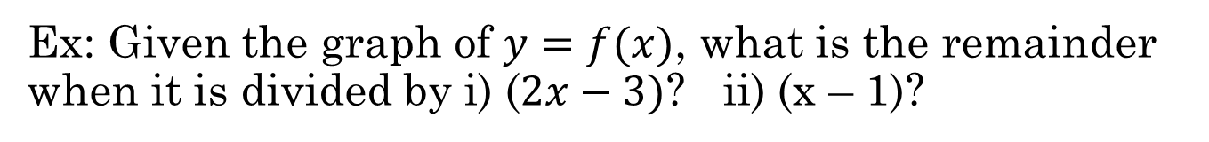
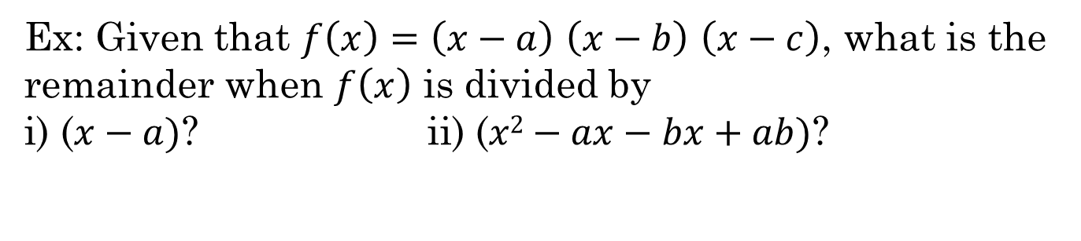
Ex: Given the graph of $y=f(x)$, what is the remainder when it is divided by i) ($2x−3)$? ii) (x – 1)?
y
a) 0 b) -1 c) 2 d) 4 e)8
6
4
2
x
-3
-2
-1
0
1
2
-2
-4
Ex: Given that $f\left(x\right)=\left(x−a\right)$ $\left(x−b\right)$ $\left(x−c\right)$, what is the remainder when $f\left(x\right)$ is divided by
i) ($x−a)$? ii) ($x2−ax−bx+ab)$?

Slide 20
Practice: Find the roots and Equation:
y
Each root is a x-intercept.
When you know the
x-intercepts, you can easily write the equation in factored form.
5
4
3
2
1
x
-1
-1
0
1
2
-2
-3
-4
-5
-6
-7
The roots are:
To find the constant “a” plug in the coordinates of a known point

Slide 21
Practice: Given the graph, find the roots, factors, and equation in factor form:
y
10
8
6
4
2
x
-5
-4
-3
-2
-1
0
1
2
3
4
5
-2
-4
-6
-8
-10
y
6
4
2
x
-3
-2
-1
0
1
2
-2
-4

